Slide 1
WHAT IS APPRAISAL?
Simon Waddington
Christine Sauter

Slide 2
by Jennifer Wright on October 12, 2012
For over a decade now, I've been responsible for appraising records and personal papers.
This is the process by which archivists determine what materials should become part of the permanent collections of the archives.
At the Smithsonian Institution Archives, our decisions are based upon our collection policies, records disposition schedules, and deeds of gift.
Before we make these decisions though, we need to learn more about the materials in question, either by getting more information from the owner or creator, or by physically examining the materials.
http://siarchives.si.edu/blog/challenges-appraising-records-digital-age

Slide 3
Good to know
The definition of appraisal depends on the context of its application.
Different contexts and domains entail different requirements that define what appraisal is about.
There are domains that use another terminology to describe the same type of operation and workflow as called here “appraisal”.

Slide 4
Appraisal in the context of
Active Recordkeeping perspective: Retaining or deleting

Slide 5
Active Recordkeeping perspective
Based on the guidance from [The National Archives 2013]
Appraisal is the process of distinguishing records:
those of continuing value
from those of no further value
Records can possess different types or degrees of value to an organisation which will affect how long collections need to be kept or when to delete data.

Slide 6
Active Recordkeeping perspective
(cont.)
In general, there are two layers of value:
Primary value = records of on-going business value for the organisation
Secondary value = additional historical and information value for the organisation and the wider society

Slide 7
What to appraise?
Value
Historical, aesthetic, scientific, financial, social judgements
Relevance to a community
Frequency of use, reuse, creation of derived works
Further factors
Increasing size and complexity of content
How faithful a representation is it of what was originally intended?
Technical feasibility
Relationship to other items in collection

Slide 8
In a nutshell
“Appraisal is the process
by which decisions on the
retention,
disposal
or transfer
of records are taken.”
[PRO, 1999]: Management, appraisal and preservation of electronic records Vol 1: Principles

Slide 9
Appraisal in the context of
Archiving legacy documents received from third parties:
Acquiring or rejecting

Slide 10
The archive
"THE SELECTION OF
RECORDS of enduring value
is the archivist's first responsibility.”
[SAA 1986]

Slide 11
The archive
The difference between between records management and archiving has lately been strongly argued as being obsolete.
The difference probably has more to do with the “enduring value” perspective than with the actual workflows and procedures.
Traditionally,
recordkeeping seemed to be more concerned with the current value and therefore integrity of a record (e.g. research data)
while the archive seemed more focused on the “legacy” value of a document (e.g. cultural heritage objects)

Slide 12
The archive
“Appraisal entails, among other things, understanding what makes records and papers authentic, reliable, and useful to institutions, individuals, legal and financial authorities, and other constituents.”
[SAA 2010]

Slide 13
Acquisition
The difference between appraisal for keeping records that one owns and for records to be acquired lie mainly in the policy driving these decisions:
shall we keep it?
shall we acquire it?
With acquisition of third party documents, appraisal will be more concerned with questions of risk assessment (can we preserve it?).
As a workflow it will likely involve the question of transfer to another repository and the technical requirements to do so.

Slide 14
by Jennifer Wright on October 12, 2012
In the past, a physical inspection of records often meant entering an office, file room, attic, or basement, and opening drawers and boxes.
While appraising records, I would sometimes make piles of the materials that should be transferred to the Archives, materials that should be destroyed, and materials that I had more questions about.
Sometimes I would also use post-it notes to label everything.
http://siarchives.si.edu/blog/challenges-appraising-records-digital-age

Slide 15
Appraisal in the context of
Lifecycle models

Slide 16
OAIS reference model
CCCDS 2012
source: http://www.jwheatley.ac.uk/mandate/Toolkit/preservationoais.htm

Slide 17
OAIS reference model
Created by the Consultative Committee for Space Data Systems (CCSDS) for use with space data, the OAIS Reference Model has been widely adopted by a broad range of non-space agencies as a general model of a preservation system for both analogue and digital data objects.
Although not specifically mentioned, appraisal would be part of the workflow between SIP (Submission Information Package) and AIP (Archival Information Package).
Generating an AIP would be based on a positive appraisal validation for preservation.

Slide 18
DCC lifecycle model
source: http://www.dcc.ac.uk/resources/curation-lifecycle-model

Slide 19
DCC lifecycle model
“Note that in the DCC model, the majority of data work prior to it's deposit in an archive or repository takes place within the "Conceptualise" and "Create or Receive" stages.
(..) this makes the DCC Model particularly relevant to academic librarians and data curators working at repositories or university libraries”
quoted from https://akthom.gitbooks.io/hkdcws/content/Day_1/Day_1_Lectures/Book/Day_1_Lecture_DC_LifeCycles.html

Slide 20
DataOne model
source: https://www.dataone.org/data-life-cycle

Slide 21
DataOne model
“Many of these stages are similar to the sequential steps described by the DCC model -- however we do note that the Data ONE model is intended to be viewed through the perspective of an independent researcher or research team undertaking curatorial tasks on their own or in occasional collaboration with a data center or archiving service.”
quoted from. Downie, J.S., Thomer, A.K., & Weber, N.M. (2015). Data Curation Workshop: University of Hong Kong. IDEALS ARK

Slide 22
Appraisal
IN TIMES OF DIGITAL RECORDS

Slide 23
by Jennifer Wright on October 12, 2012
Over the last few years though, I've been asked to appraise electronic files with increasing frequency. Suddenly, I'm not perusing filing cabinets but sitting in front of a computer systematically clicking through folders.
Or I'm putting disk after disk into a drive.
Files are not always intuitively named, particularly if they were created at a time when file names could only be eight character long.
This results in me needing to open the files to see what they are, but compatible hardware and software are not always immediately available.
An organized folder structure allows me to make educated guesses about the contents of the files, but it's not uncommon to find a single generic folder to which all of the files have been saved.
http://siarchives.si.edu/blog/challenges-appraising-records-digital-age

Slide 24
Why is appraisal difficult?
Hard to define criteria precisely
The criteria used in the literature is rather broad
The criteria will often depend on external information
Typically a manual task
carried by a human agent on item-level
therefore expensive
and impracticable for large collections
Context dependent
e.g. on the appraiser, the organisation, the current trends (artistic taste, research interests, etc.), user communities, etc.
the context is likely to be subject to change
It is biased
How to convey under what assumptions selection has been made?

Slide 25
Types of appraisal
Technical appraisal
decisions based on the (on-going) feasibility of preserving the digital objects. This involves determining whether digital objects can be maintained in a reusable form and in particular takes into account obsolescence of software, formats and policies.
Content-based (or intellectual) appraisal
acquisition and retention decisions or assignment of value based on the content of the digital objects themselves.

Slide 26
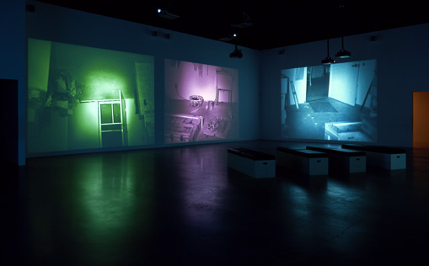
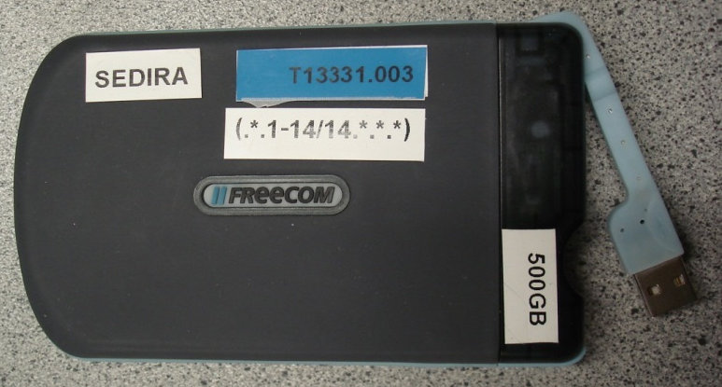
Example: Media art appraisal
Issues to be considered:
Fragility of content
Usability
Ephemeral nature
Subjectivity
Determining audience
Appraisal supports acquisition and retention decisions
Often made on senior level

Slide 27
Approaches to appraisal
Top-down approach (mission alignment*)
Does it comply with the legal framework?
What does the policy dictate?
What is the record’s function within the organisation?
What is its value for money?
Bottom-up approach
Using the metadata extracted from the content and environment
* term borrowed from Jinfang Niu
http://www.ijdc.net/index.php/ijdc/article/view/9.2.65

Slide 28
Yet another model?
The Records Continuum Model (RCM) was created in the 1990s by Monash University academic Frank Upward with input from colleagues Sue McKemmish and Livia Iacovino as a response to evolving discussions about the challenges of managing digital records and archives.
source: Wikipedia, “Records Continuum Model”
https://en.wikipedia.org/wiki/Records_Continuum_Model#cite_note-U.26M1994-17

Slide 29
Records continuum model

Slide 30
RCM and lifecycle models
The RCM is often described as being in contrast or at odds with the lifecycle records model.
The lifecycle approach identifies clear conceptual and procedural boundaries between active or current records and inactive or historical records -> “relic”
A continuum approach sees records processes as more integrated across spacetime -> “a state of always becoming”
source: Wikipedia, “Records Continuum Model”
https://en.wikipedia.org/wiki/Records_Continuum_Model#cite_note-U.26M1994-17

Slide 31
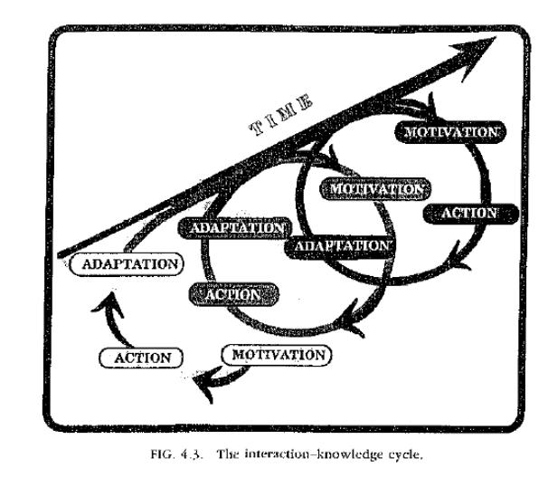
“a state of always becoming”

Slide 32
The post-custodial theory
The post-custodial theory is strongly linked to the Records continuum theory:
The postcustodial theory shifts the role of the archivists from a custodian of inactive records in a centralized repository to the role of a manager of records that are distributed in the offices where the records are created and used.
source: Society of American Archivists (Glossary)
http://www2.archivists.org/glossary/terms/p/postcustodial-theory-of-archives

Slide 33
Appraisal and continuum
Appraisal needs to be performed at multiple points in the “life” of a digital object – including its creation.
In line with the understanding of preservation as
"an ongoing, long-term commitment, often shared, and cooperatively met, by many stakeholders"
(Lavoie & Dempsey, 2004)

Slide 34
Appraisal of digital objects
Digital objects often have multiple dependencies that need to be taken into account when appraising the effort to keep them accessible over time.
Complex digital objects require an array of expertise to appraise their value
This requires a lot of resources, and is increased if the need for re-appraisal in evolving ecosystems are understood.

Slide 35
Example for the complex user communities in science
Payload engineer
Engineering data
Space agencies (e.g. NASA, ESA
Reuse
Scientists (different domain)
Shared knowledge
Science data
Operations data
Scientists (same domain)
Creation and reuse
Mission Operator
SOLAR scientist

Slide 36
Appraisal
taking account of changing environments

Slide 37
Appraising change
To estimate the risk of changing environments for an object under appraisal, three dimensions are to be considered:
Risk – probability of an entity being non-usable
Proximity – time frame in which we consider risk/impact
Impact – potential loss of functionality and cost of mitigating actions

Slide 38
Another angle
Appraising potential risks, their impact, likelihood and timely occurrence as a consequence of changes related to digital objects differs from the Appraisal of the value of a digital object at accession.
Appraising the object = What to preserve?
Appraising the risks = Can we preserve?

Slide 39
An added aspect
To the traditional understanding of appraisal as
“[…]the process by which decisions on the
retention, disposal or transfer
of records are taken.”
[PRO, 1999]: Management, appraisal and preservation of electronic records Vol 1: Principles
the aspect of change and ensuing need of mitigation would add appraisal as a process by which decisions on
modifying the records or creating a new version
of records are taken.

Slide 40
Types of risk
Change might jeopardise access and reuse of a digital object:
Primary risk
arising to a digital object through a stimulus that is external to the ecosystem
Secondary (or higher order) risk
impacting a digital object as a result of a potential change to another entity on which it has a dependency

Slide 41
Mitigation and re-appraisal
Mitigation (or preservation action)
Process to transform entities in ecosystem
E.g. Transcoding, software upgrade, hardware replacement
Preservation actions allow to maintain data in a reusable form
Every preservation action requires an appraisal
perform a risk assessment to understand the potential impact and the costs of preservation actions

Slide 42
Steps in appraisal
Assess primary risks
Determine changes, probability and proximity
Determine secondary risks
Determine potentially affected entities
Probabilities of occurrence
Determine mitigating actions
Determine potential preservation actions
Estimate cost/impact
Present options to user
Implement and validate potential actions

Slide 43
Appraisal
a tool as automated support

Slide 44
Requirements for appraisal tool
What should an appraisal tool be able to do?
Provide assessments of risk, proximity (i.e. timescale in which the risk is expected to occur) and impact
Be largely automated
Manual subjective assignment of risk should be avoided
Easy to use
By e.g. supporting visualisation of risk, proximity and impact.
Where possible, preservation actions should be proposed and automated
Provide on-going, not just one-off assessments

